Slide 1


Team D
TEAM MEMBERS
Rabjyotsingh Majethiya
RM
RC
Ruchita Jagdish Chaudhari
SL
S.A.R.V. Likhith
SC
Sachin Chaubey
We have successfully completed this project under the guidance of our mentor Mrs. Sophia.
SH
Shravani Gajanan Hiwase
TR
Trijit Roy
VS
Vegi Sangeetha
Notes:
We have successfully completed this project under the guidance of our mentor Mrs. Sophia. Team D: Rabjyotsingh Majethiya, Ruchita Jagdish Chaudhari, S.A.R.V. Likhith, Sachin Chaubey, Shravani Gajanan Hiwase, Trijit Roy and Vegi Sangeetha.

Slide 2




Prediction AI
INTRODUCTION
Risk scoring
SWOT & market
Overall risk and success probability
Feasibility, market size, competitors
Startup & Project Risk Analyzer
Founders, students and project teams often invest in an idea without seeing the market, budget and planning risks behind most failures. Prediction AI analyses the idea, scores its risk and recommends how to reduce it.
AI advice
Dashboard
Gemini recommendations and mitigation
Risk analytics and exportable report
COLLECT
ASSESS
RECOMMEND
REPORT
Project data and market intelligence
Risk scoring and SWOT analysis
Strategic reasoning and mitigation
Dashboard, reports and deployment
Notes:
Prediction AI is a Startup & Project Risk Analyzer. The platform collects project data and market intelligence, assesses risk with a SWOT, recommends mitigation using Gemini and a LangGraph agent, and reports through a dashboard.

Slide 3





The Problem
Promising ideas often fail for reasons that can be spotted early
Entrepreneurs, students and project teams invest time, effort and money in ideas without fully understanding the risks that can sink them.
Poor market fit
Building something customers do not need
Intense competition
Established players already own the segment
Budget limitations
OUR ANSWER
Funds run out before the idea proves itself
Prediction AI predicts failure risk before the investment is made, scores it, and recommends how to reduce it.
Operational challenges
Teams and processes cannot deliver the plan
Inadequate planning
No clear roadmap or fallback plan
Notes:
Many startups, business plans, hackathon solutions and college projects fail because of poor market fit, intense competition, budget limits, operational challenges or inadequate planning. Prediction AI predicts these risks before the investment is made.

Slide 4





Objectives and Outcomes
What Prediction AI delivers to every user
Idea evaluation
Risk scoring
SWOT analysis
Market and competitors
AI review of startup ideas and project plans
Overall risk and success probability
Strengths, weaknesses, opportunities, threats
Market opportunity and competitor insight
Critical risks
Mitigation
Dashboard
Feasibility reports
Business, technical, financial, operational
Personalised strategies and improvements
Interactive risk visualisation
Exportable viability and assessment reports
Notes:
Eight outcomes: AI evaluation of ideas, automated risk scoring and success probability, SWOT generation, market and competitor analysis, identification of critical risks, personalised mitigation, an interactive dashboard and feasibility reports.

Slide 5
Core Modules
Six modules working together as one pipeline
1
Idea & Project Information Collection
2
Market & Competitor Intelligence
3
Risk Assessment & Scoring
Captures the idea, target market, budget, resources and objectives, and stores each proposal.
Analyses the target market, key competitors, industry challenges and growth potential.
Evaluates business, financial, operational and technical risk and prioritises high-impact factors.
4
SWOT & Strategic Evaluation
5
Recommendation & Mitigation
6
Dashboard & Reporting
Generates the SWOT, checks feasibility and sustainability, and highlights strategic gaps.
Produces actionable recommendations, mitigation strategies and improvement plans.
Visualises risk, builds assessment reports and shares business insights.
Notes:
The six modules: information collection, market and competitor intelligence, risk assessment and scoring, SWOT and strategic evaluation, recommendation and mitigation, and dashboard and reporting.

Slide 6






Tech Stack
One Python codebase, from data collection to deployment
Python
Streamlit
Google Gemini
LangGraph
SQLite
CORE LANGUAGE
WEB DASHBOARD
LLM REASONING
AGENT WORKFLOW
LOCAL DATABASE
Modular backend with one file per engine: risk, SWOT, feasibility and reports.
Four tabs: Project Input, Risk Assessment, Recommendations and Dashboard.
Writes recommendations and insights. Demo Mode works without an API key.
Six connected nodes share one state, from input to final response.
Stores projects, risks, recommendations and reports. No server needed.
Deployed on Streamlit Cloud
A Streamlit front end, Gemini reasoning orchestrated by LangGraph, and results stored in SQLite, all in one Python app.
https://prediction-ai-app.streamlit.app/
Notes:
Python for the modular backend, Streamlit for the four-tab UI, Gemini for strategic reasoning (API key from an environment variable, Demo Mode without it), LangGraph for the agent workflow and SQLite as the database. Deployed on Streamlit Cloud.

Slide 7
Tech Stack Evolution
How the tools changed as the project grew
INTERFACE
DATA
INTELLIGENCE
Data collection
Flask + Jinja templates
PostgreSQL, psycopg2, Pandas
Gemini / OpenAI and LangGraph planned
Risk & SWOT
Streamlit: selectboxes, sliders, metrics
Risk, SWOT and prediction tables
Rule-based risk, SWOT and feasibility engines
Recommendations
Streamlit tabs
SQLite with five linked tables
Gemini plus a six-node LangGraph agent
Dashboard & launch
Streamlit dashboard, deployed online
SQLite, analytics-ready tables
Same agent feeds the final report
Notes:
The first stage used Flask, Jinja, psycopg2, Pandas and PostgreSQL, with Gemini/OpenAI and LangGraph planned. The interface then moved to Streamlit with pure-logic Python engines, Gemini and the LangGraph agent were added with SQLite, and finally the dashboard was built and deployed.

Slide 8


System Flow
From a submitted idea to an exportable risk report
Project input
Market & competitor intel
Risk scoring & SWOT
AI advice
Saved to SQLite
Dashboard & report
Name, industry, model, market, budget, description
TAM, SAM, SOM and competitor landscape
Risk score, success probability, SWOT, feasibility
Gemini recommendations and mitigation through LangGraph
One saved result feeds the dashboard and report
Risk analytics, assessment report, Export and Share
Inside the LangGraph agent
1 Project analysis
analyze_project
2 Risk analysis
analyze_risks
3 Recommendation
generate_recommendations
Every node reads one shared state, adds its output and hands it on. With no API key, Demo Mode still completes the run.
4 Mitigation
generate_mitigation
5 Improvements
generate_improvements
6 Final response
generate_final_response
Notes:
Walk left to right: collect the project and market data, score risk and build the SWOT, run the LangGraph agent with Gemini, save to SQLite, then show everything on the dashboard and in the exportable report. The panel lists the six LangGraph nodes.

Slide 9
System Architecture
A layered design that carries an idea from the user to the database and back
Users
Entrepreneurs
Startup founders
Students
Hackathon teams
Business analysts
Presentation
Streamlit dashboard
Project input
Risk analytics
Assessment reports
Analysis
Market intelligence
Risk scoring
SWOT analysis
Feasibility
AI orchestration
LangGraph agent
Gemini LLM
Recommendations
Mitigation
Data
SQLite database
Project records
Risk results
Analytics logs
Notes:
Layers from top to bottom: users, the Streamlit presentation layer, the analysis engines (market intelligence, risk scoring, SWOT, feasibility), AI orchestration with a LangGraph agent and Gemini, and the SQLite data layer.

Slide 10




Risk Assessment Engine
Five risk categories feed a single score
Financial
Market
Technical
Operational
Execution
Budget constraints and funding runway
Competitor density and research quality
Team expertise and innovation level
Resource availability and day-to-day operations
Capability to deliver the plan
Inputs
Scoring model
Outputs
Project details and market data
Five risk inputs
Four feasibility sliders
Combines the five risk categories
Prioritises high-impact risk factors
Calculates a separate feasibility score
Overall risk score and risk status
Success probability
Feasibility score
Notes:
The engine analyses five risk categories: financial, market, technical, operational and execution. Inputs from the project form and the sliders feed the scoring model, which outputs the overall risk score, risk status, success probability and feasibility score.

Slide 11
AI Recommendation Engine
From identified risks to prioritised, actionable advice
Anatomy of a recommendation
Strategic Recommendations
Ranked action cards tied to the risks found
Category
Technical, Financial or Market
Priority
Critical, High or Medium
Risk Mitigation
A mitigation strategy for each identified risk
Problem
The risk found in the project
Why it matters
How it can hurt the project
Improvements
Ideas to lift opportunity, team, advantage and resources
Recommended action
What to do about it
Risk reduction
The improvement it brings
Powered by Gemini through the LangGraph agent. Demo Mode keeps it running without an API key.
Notes:
Every recommendation card follows the same structure: category, priority, problem, why it matters, recommended action and risk reduction. The engine produces strategic recommendations, risk mitigation strategies and improvement suggestions, using Gemini through the LangGraph agent, with Demo Mode when no API key is set.

Slide 12



Database Structure
SQLite: one project row, many linked result rows
Projects
Risk_Assessments
SWOT_Analysis
Success_Predictions
risk_id PK
project_id FK
risk_category
risk_score
risk_description
priority_level
swot_id PK
project_id FK
strengths
weaknesses
opportunities
threats
generated_at
prediction_id PK
project_id FK
success_probability
overall_risk_score
prediction_date
project_id PK
user_id FK
project_name
project_type
budget
target_market
description
created_at
Recommendations
Assessment_Reports
Analytics_Logs
recommendation_id PK
project_id FK
recommendation_text
risk_mitigation
priority
generated_at
report_id PK
project_id FK
report_path
generated_at
log_id PK
user_id FK
activity_type
timestamp
Every result table links back to a project through project_id. Analytics_Logs links through user_id.
Notes:
Projects holds one row per analysed project. Result tables (risk assessments, SWOT, success predictions, recommendations, assessment reports) link back through project_id; analytics logs link through user_id. Table names follow the project brief; adjust if your SQLite table names differ.

Slide 13




Who It Helps and Success Targets
Built for people who need to decide before they invest
Who it helps
Success targets
Entrepreneurs
Test an idea before committing capital
5 sec
85%+
Startup founders
See market and funding risks early
Target time to generate an assessment report
Target user satisfaction during testing
Students
Strengthen college and capstone projects
Hackathon teams
Consistent
Aligned
Judge whether a solution can succeed
Business analysts
Risk scoring that gives repeatable evaluations
Recommendations that match the identified risks
Back viability decisions with data
Notes:
The platform serves entrepreneurs, startup founders, students, hackathon teams and business analysts. Success targets: reports generated within 5 seconds, user satisfaction of at least 85% in testing, consistent risk scoring and recommendations aligned with the identified risks.

Slide 14

Future Scope
Where Prediction AI can grow next
Live market data
Multi-user accounts
Compare ideas
Pull real-time market and competitor data into every analysis.
Give each user saved projects and a history of past assessments.
Rank several ideas side by side to choose the strongest one.
Industry-specific models
Richer reports
Progress tracking
Tune risk scoring and benchmarks to each sector.
Export investor-ready PDF and slide reports in one click.
Re-score a project over time and track how its risk changes.
Notes:
Possible next steps for the platform: live market data feeds, multi-user accounts with saved history, side-by-side comparison of ideas, industry-specific risk models, richer investor-ready reports and progress tracking over time.

Slide 15

Milestone 1: Tasks and Tools
MILESTONE 1
Data Collection & Market Intelligence
Submission forms
TOOLS USED
Startup and project forms capture name, industry, business model, target market, budget and description.
Flask
Python web framework and routing
Jinja templates
Market and competitor analysis
Server-rendered HTML views
TAM, SAM and SOM, a 2020–2026 market trend and a competitor landscape for every submission.
PostgreSQL + psycopg2
Relational store and its driver
Pandas
PostgreSQL storage
Data processing and shaping
Project details saved in a projects table with name, industry, model, market, budget and timestamp.
Gemini / OpenAI + LangGraph
Planned intelligence layer
Notes:
Milestone 1: three tasks. Submission forms for startup and project details, market and competitor analysis (TAM/SAM/SOM, 2020-2026 trend, competitor table), and storing project data in PostgreSQL. Built with Flask, Jinja templates, psycopg2, Pandas and PostgreSQL, with Gemini/OpenAI and LangGraph planned for the intelligence layer.

Slide 16
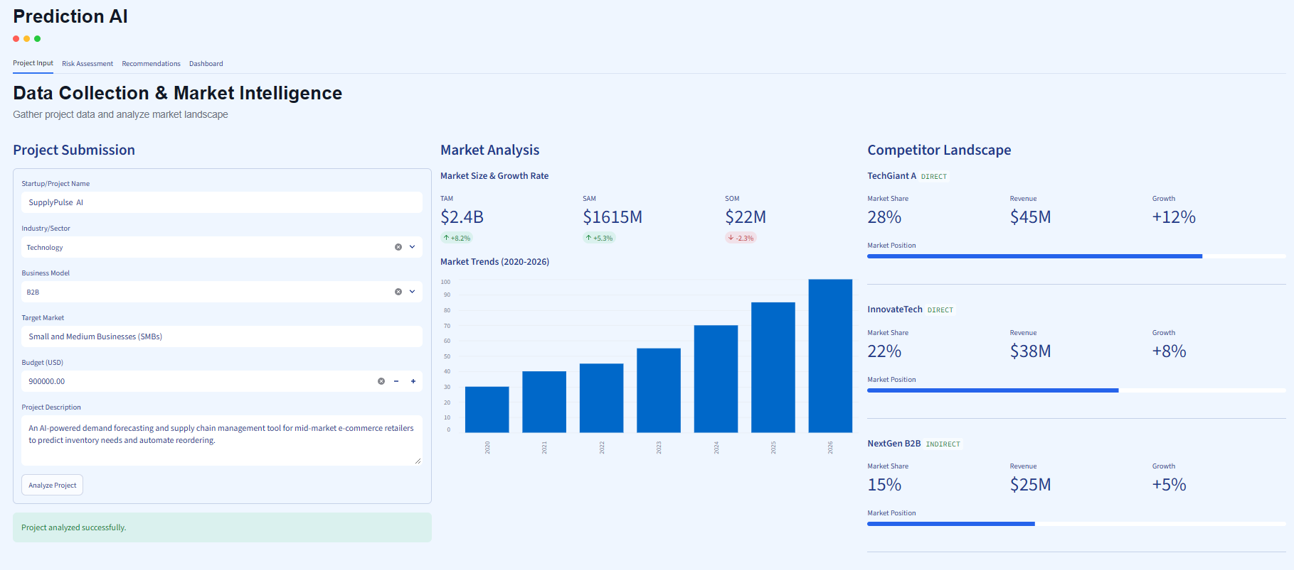
Milestone 1: In Action
MILESTONE 1
Project Input tab: submission form, market analysis and competitor landscape
Project Submission
prediction-ai-app.streamlit.app
Name, industry, business model, target market, budget and description.
Market Analysis
TAM, SAM and SOM with growth indicators and a 2020–2026 market trend.
Competitor Landscape
Direct and indirect competitors with market share, revenue and growth.
Notes:
Project Input tab. The user submits the startup details and clicks Analyze Project. The app returns TAM, SAM and SOM, the 2020-2026 market trend and the competitor landscape.

Slide 17
Milestone 2: Tasks and Tools
MILESTONE 2
Risk Assessment & SWOT Analysis
Risk scoring engine
TOOLS USED
Five weighted inputs combine into a 0–100 risk score, a risk status and a success probability.
Streamlit
Selectboxes, sliders and live metrics
risk_engine.py
Automatic SWOT
Weighted risk score and status
Strengths, weaknesses, opportunities and threats generated by rules from the same five inputs.
swot_analysis.py
Rule-based SWOT generation
feasibility.py
Feasibility assessment
Average of four slider scores
Four slider scores (market, team, edge, resources) average into one feasibility percentage.
Python
Pure-logic modules, no front-end code
Notes:
Milestone 2: the analytical core. A risk scoring engine, automatic SWOT generation and a project feasibility assessment. The UI moved to Streamlit and three pure-logic Python modules were added: risk_engine.py, swot_analysis.py and feasibility.py.

Slide 18
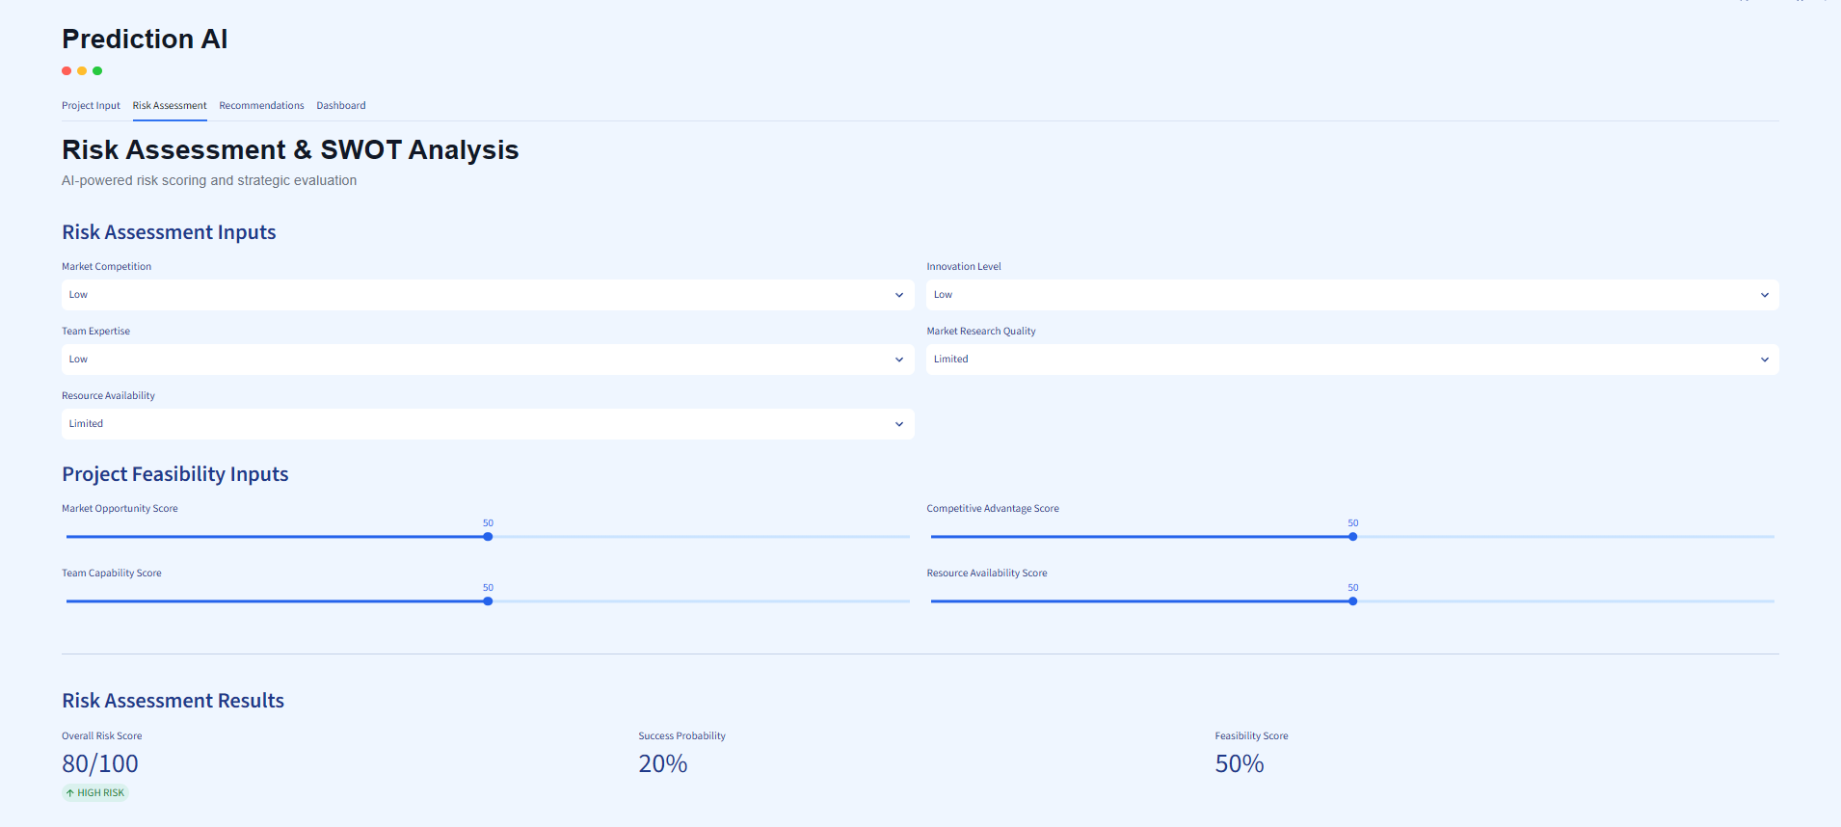
Milestone 2: In Action
MILESTONE 2
Risk Assessment tab: the inputs that drive the analysis
Risk Assessment Inputs
prediction-ai-app.streamlit.app
Five selections: market competition, innovation level, team expertise, market research quality and resource availability.
Project Feasibility Inputs
Four sliders: market opportunity, competitive advantage, team capability and resource availability.
Assessment Results
The overall risk score with its risk status, the success probability and the feasibility score.
Notes:
Risk Assessment tab inputs. Five selections (market competition, innovation level, team expertise, market research quality, resource availability) and four feasibility sliders (market opportunity, competitive advantage, team capability, resource availability) drive the assessment results.

Slide 19
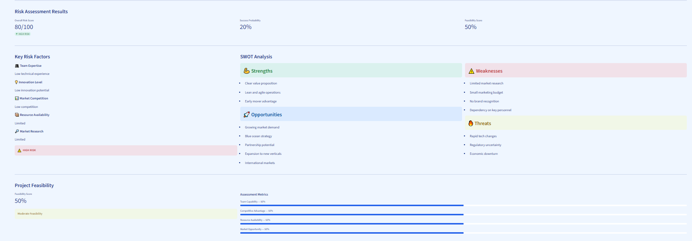
Milestone 2: Output
MILESTONE 2
Results of the Risk Assessment tab and what each part shows
prediction-ai-app.streamlit.app
SWOT Analysis
Key Risk Factors
Assessment Results
Project Feasibility
Strengths, weaknesses, opportunities and threats generated automatically.
Each of the five inputs is read back with its risk level.
Overall risk score, risk status and success probability.
A feasibility score built from four assessment metrics.
Notes:
Output of the Risk Assessment tab: the assessment results, key risk factors, the automatically generated SWOT analysis and the project feasibility score with its four assessment metrics.

Slide 20
Milestone 3: Tasks and Tools
MILESTONE 3
Recommendations & Strategic Reasoning
Gemini recommendations
TOOLS USED
Strategic, risk-based, market, technical, financial and operational advice with priorities.
Python
Modular files, one per engine
Streamlit
Mitigation and improvement engine
Four tabs for the dashboard
A mitigation strategy for each major risk, plus practical improvements across the project.
Google Gemini
Key read from an environment variable
LangGraph
LangGraph agent workflow
Six nodes sharing one state
Six connected nodes share one state from input to final response, with a Demo Mode fallback.
SQLite
Local database, no server needed
Notes:
Milestone 3: turn risk scores into actions. Gemini-powered strategic recommendations, a mitigation and improvement engine, and a LangGraph agent workflow. SQLite replaced PostgreSQL as the local database so the prototype runs without an external server.

Slide 21
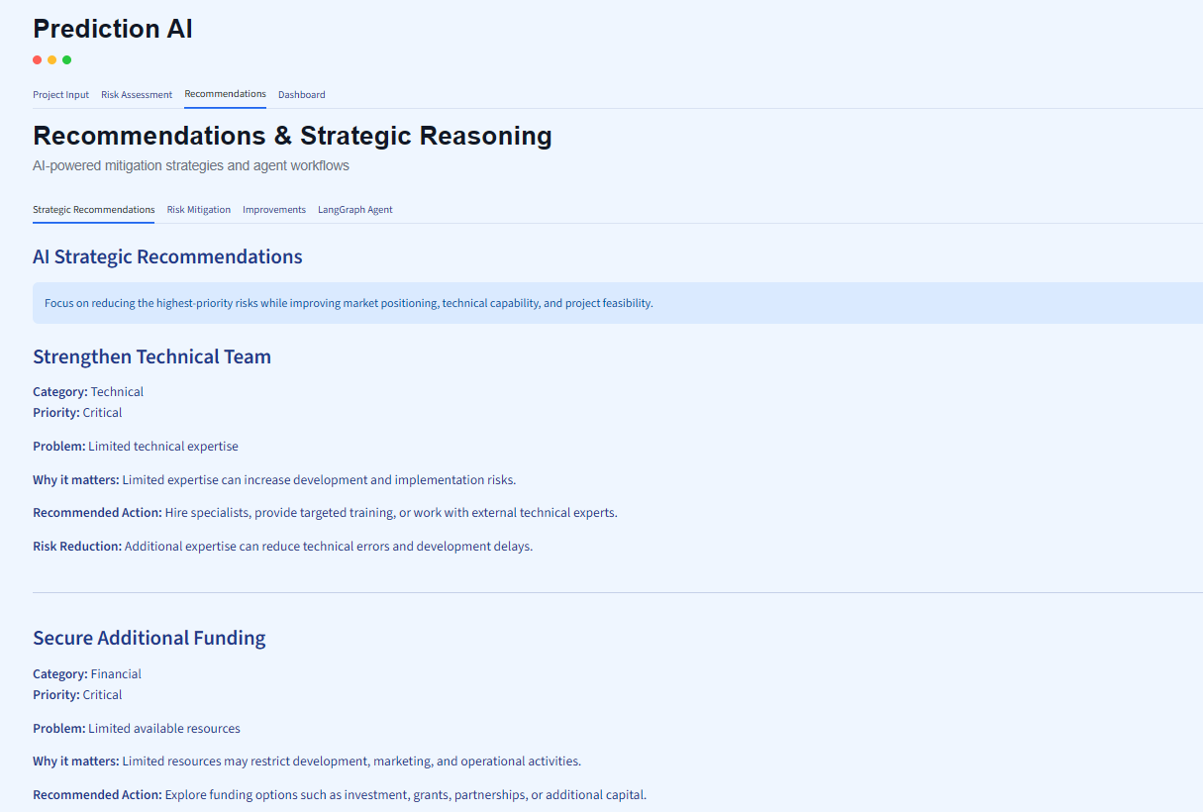
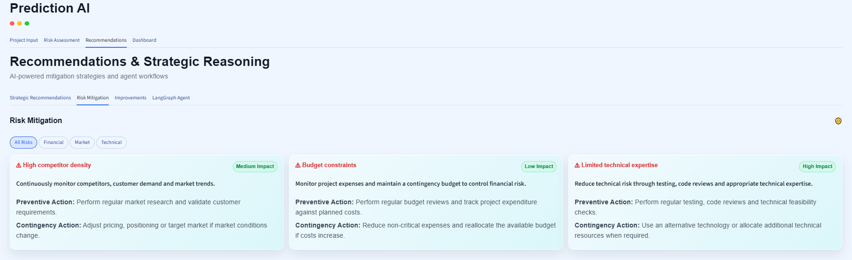
Milestone 3: Recommendations
MILESTONE 3
Strategic Recommendations and Risk Mitigation sub-tabs
prediction-ai-app.streamlit.app
prediction-ai-app.streamlit.app
Strategic Recommendations
Risk Mitigation
Action cards ranked Critical, High or Medium, each with problem, why it matters, action and risk reduction.
Filter by All Risks, Financial, Market or Technical. Each risk card shows its impact level, a mitigation strategy, a preventive action and a contingency action.
Notes:
Strategic Recommendations: Gemini-powered action cards ranked Critical, High and Medium. Risk Mitigation: filter by category; each risk shows its impact level, mitigation strategy, preventive action and contingency action.

Slide 22
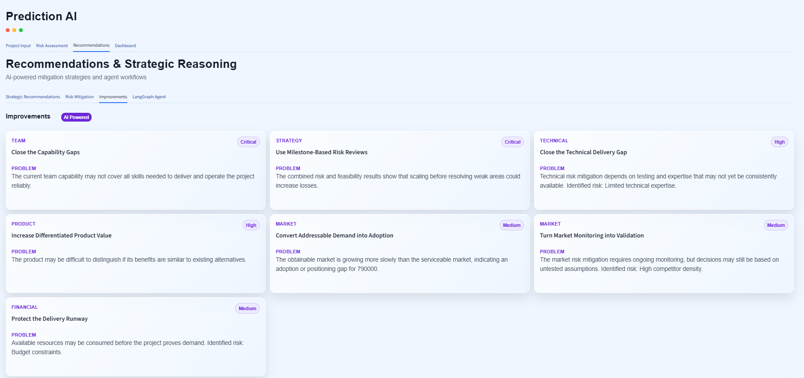
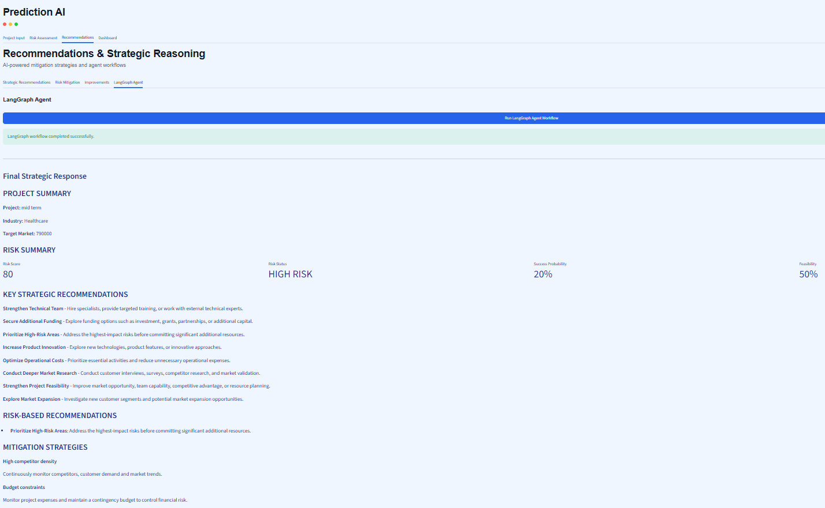
Milestone 3: Improvements and Agent
MILESTONE 3
Improvements and LangGraph Agent sub-tabs
prediction-ai-app.streamlit.app
prediction-ai-app.streamlit.app
Improvements
LangGraph Agent
AI-powered cards grouped by area (team, strategy, technical, product, market and financial), each with a priority and the problem it addresses.
One button runs the six connected nodes, then shows the final strategic response.
Notes:
Improvements: AI-powered cards by area with a priority and the problem addressed. LangGraph Agent: one click runs the six-node workflow (project analysis, risk analysis, strategic recommendation, mitigation, improvements, final response) sharing one state, then shows the final strategic response. Demo Mode is used when no API key is set.

Slide 23


Milestone 4: Tasks and Targets
MILESTONE 4
Dashboard & Deployment
Risk analytics dashboard
EVALUATION TARGETS
Overall, success, market and tech risk tiles with change indicators and a 6-month trend.
Dashboard fully operational
Assessment reports
End-to-end risk analysis workflow functional
Key findings, risk assessment and recommendations, with Export and Share, plus strategic insights.
Assessment reports generated within 5 seconds
Testing, optimization, deployment
The full flow tested and optimized, then the final app deployed online.
User satisfaction of 85% or higher
Notes:
Milestone 4: the dashboard, assessment reports, and then testing, optimization and deployment. Evaluation targets: dashboard fully operational, end-to-end workflow functional, reports within 5 seconds and user satisfaction of at least 85%.

Slide 24
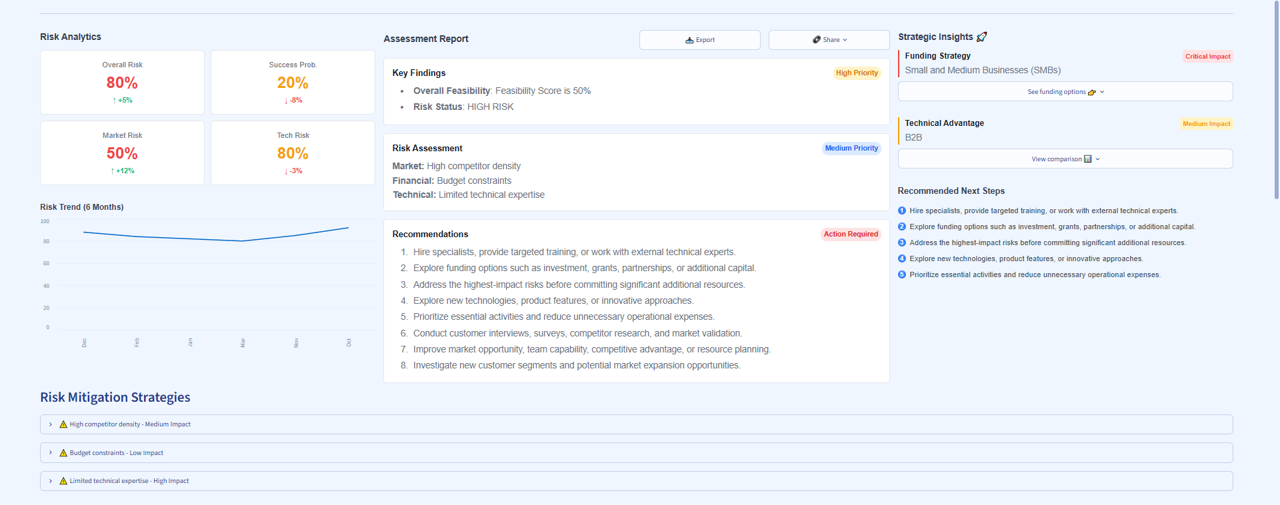
Milestone 4: In Action
MILESTONE 4
Dashboard tab: analytics, assessment report and strategic insights
prediction-ai-app.streamlit.app
TOOLS USED
Python
Application logic and report building
Streamlit
Dashboard tiles, Export and Share
Google Gemini
Recommendations and strategic insights
LangGraph
Agent workflow behind the report
Risk analytics
Assessment report
Strategic insights
Overall, success, market and tech risk plus a trend.
Findings and recommendations, with Export and Share.
Funding strategy and recommended next steps.
SQLite
Saved results the dashboard reads
Notes:
Dashboard tab. Risk analytics tiles show overall risk, success probability, market risk and tech risk with a 6-month trend. The assessment report lists key findings, the risk assessment and recommendations, with Export and Share. Strategic insights show funding strategy, technical advantage and recommended next steps. Tools used: Python, Streamlit, Google Gemini, LangGraph and SQLite.

Slide 25
Milestone 4: Testing & Deployment
MILESTONE 4
Prove it works, then put it online
Test
Optimize
Deploy
Run the full flow from project input to the exported report and check every tab.
Tune the app so reports are generated within 5 seconds.
Publish the Streamlit app online so anyone can use it from a browser.
LIVE DEPLOYMENT
https://prediction-ai-app.streamlit.app/
Open in any browser to try Prediction AI
Notes:
Testing and deployment: the end-to-end flow was tested, report generation optimized toward the 5 second target, and the Streamlit app deployed. Live link: https://prediction-ai-app.streamlit.app/

Slide 26
Closure
Thank you
Risk score and success probability
SWOT, feasibility and market intelligence
Prediction AI helps founders and students see the risks before they invest, and gives them clear steps to reduce them.
Questions?
Gemini advice through a LangGraph agent
Dashboard with an exportable report
Notes:
Wrap up: Prediction AI delivers a risk score and success probability, SWOT and market intelligence, Gemini advice through LangGraph, and a dashboard with an exportable report. Thank the audience and open for questions.

